Slide 1
Deception Detection using Facial Action Units
Emanuele Orfanelli – Sapienza – Laurea Magistrale in Informatica AA. 2017/2018

Slide 2
Introduction
Deception Detection
Many ways to detect lies
FACS
AUs
Architecture
Dataset
Facial Landmarks
Extraction of Features
Action Unit presence/intensity
SVC
Result
Problems
Future
Thanks

Slide 3

What is Deception Detection?

Slide 4

There are many ways to detect lies
Psychology
Body language, micro-expressions, eye position
Speech analysis
Speed, patterns, words
Neuroscience
EEG, fMRI
Thermal Imaging
More….

Slide 5
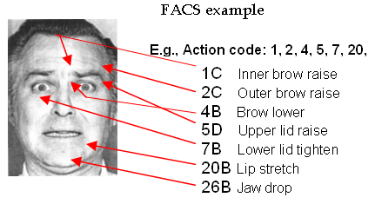
Action Units
Action Units (AU) are a contraction or relaxation of one or more muscles.
AUs can be used to codify emotions through the muscles involved.

Slide 6
Facial Action Coding System
Codify all AUs into expressions

